Slide 1



SIMPLIFYING LIBRARY OPERATIONS WITH A ROBUST SQL-BASED MANAGEMENT SYSTEM
Presented by: Usman Shaikh

Slide 2






LIBRARY MANAGMENT
1.INTRODUCTION
4.SQL QUERIES
2.PROJECT OBJECTIVES
5.CONCLUSION
3.DATABASE STRUCTURE
6.CONTACT/LINKS

Slide 3




CONNECT WITH USMAN SHAIKH: LET'S COLLABORATE AND INNOVATE
EXPLORE MY PROJECTS AND CONNECT WITH ME TO SHARE IDEAS, OPPORTUNITIES, AND INNOVATIONS. LET’S BUILD THE FUTURE TOGETHER!

Slide 4


1.INTRODUCTION
The Library Management System SQL project is a comprehensive database system designed to efficiently manage books, members, loans, and fines in a library. This report covers the database structure, queries, and use cases, highlighting the practical implementation of SQL commands.
Technologies Used: SQL, MySQL, etc.

Slide 5



2.PROJECT OBJECTIVES

Slide 6






SEARCHING
READING

Slide 7



OBJECTIVE
OBJECTIVE
Efficiently manage book inventories
Ensure accurate tracking of all books in the library's collection, including new acquisitions and removals.
Track members and their loan histories
Keep a comprehensive record of member details, their borrowing activities, and due dates.

Slide 8
OBJECTIVE
OBJECTIVE
Automate fines calculation for late returns
Implement automatic fine calculation for overdue books, reducing manual effort.
Provide a system for querying book availability
Enable real-time search and status checking for books, allowing members and staff to easily find available or borrowed items.

Slide 9



3.DATABASE STRUCTURE

Slide 10




DATABASE STRUCTURE
ER DIAGRAM/SCHEMA
Books linked to Book Authors (many-to-many relationship with Authors).
Books linked to Loans (one-to-many relationship with Loans).
Members linked to Loans (one-to-many relationship with Loans).
Loans linked to Fines (one-to-one relationship with Fines).

Slide 11
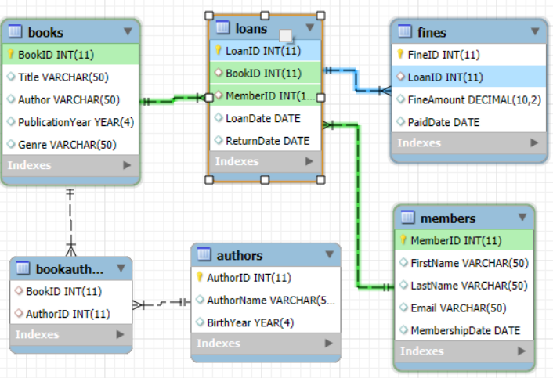
ER DIAGRAM/SCHEMA

Slide 12



4.SQL QUERIES

Slide 13
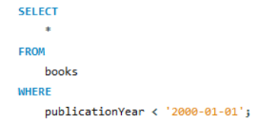
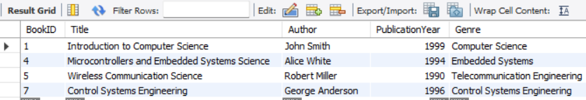

QUESTION
Write a query to select all books published before 2000 from the Books table.
QUERY EXECUTION
RESULTS

Slide 14
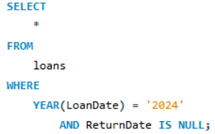
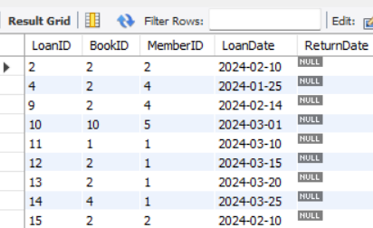
QUESTION
Write a query to select all Loans where the LoanDate is in 2024 and the ReturnDate is NULL
QUERY EXECUTION
RESULTS

Slide 15
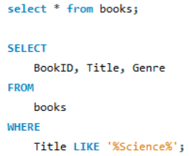
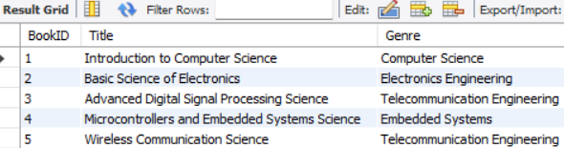
QUESTION
Write a query to select all Books where the Title contains 'Science'.
QUERY EXECUTION
RESULTS

Slide 16
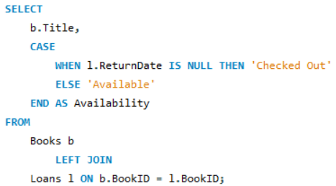
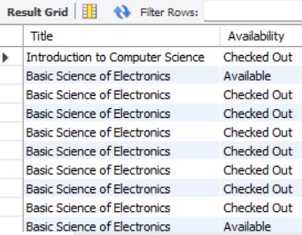
Write a query to select Title and a new column Availability from the Books table.
If a book has been loaned out (i.e., exists in Loans table with a NULL ReturnDate),
set Availability to 'Checked Out', otherwise 'Available'.
QUESTION
QUERY EXECUTION
RESULTS

Slide 17
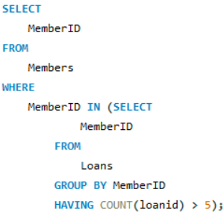
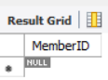
Write a query to find all Members who have borrowed more than 5 books.
Use a subquery to find these MemberIDs.
QUESTION
QUERY EXECUTION
RESULTS

Slide 18
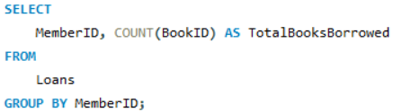
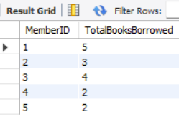
Write a query to get the total number of books borrowed by each Member. Group the results by MemberID.
QUESTION
QUERY EXECUTION
RESULTS

Slide 19
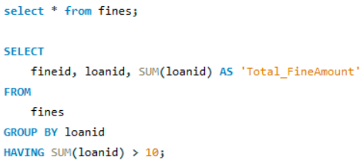
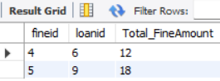
Write a query to get the total FineAmount collected for each LoanID,
but only include loans where the total fine amount is greater than $10. Use the HAVING clause.
QUESTION
QUERY EXECUTION
RESULTS

Slide 20
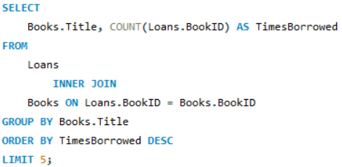
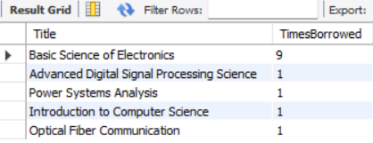
QUESTION
Write a query to select the top 5 most frequently borrowed books.
QUERY EXECUTION
RESULTS

Slide 21
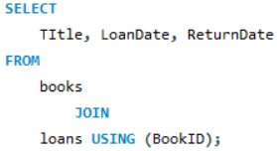
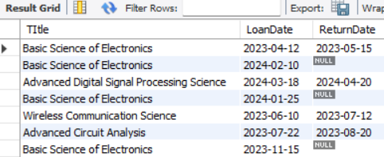
QUESTION
Write a query to join Loans with Books to get a list of all loans with Title, LoanDate, and ReturnDate.
QUERY EXECUTION
RESULTS

Slide 22
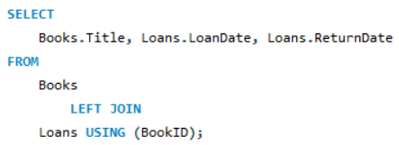
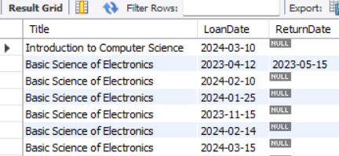
QUESTION
Write a query to get a list of all Books and any associated loans.
Include books that might not be currently borrowed.
QUERY EXECUTION
RESULTS

Slide 23


5.CONCLUSION

Slide 24


#CONCLUSION
STREAMLINING LIBRARY OPERATIONS WITH SQL
Efficient database management improved book loans, member tracking, and fine calculations.
LEARNINGS AND FUTURE PROSPECTS
Mastered advanced SQL techniques and explored potential applications for larger-scale systems.

Slide 25



ANALYSIS
EFFICIENCY IN DATABASE MANAGEMENT
PRACTICAL APPLICATION OF SQL SKILLS
The SQL-based system streamlined everyday library tasks like managing book loans and calculating fines, making processes smoother and more accurate, similar to how digital systems have transformed services in Indian libraries.
This project allowed you to apply advanced SQL concepts in a real-world scenario, much like the way databases are used to manage large amounts of data in sectors like education and retail in India, improving overall workflow.

Slide 26

Data is the fuel of the future, and SQL is the engine that drives it forward.

Slide 27


CONCLUSION
This project successfully demonstrated how SQL can streamline library operations, enhancing efficiency in managing book loans, members, and fines, while also sharpening my SQL skills for future applications.

Slide 28
THANK YOU !
Thank you for your interest in my project. I hope it showcases the potential of SQL in real-world applications and inspires further exploration in data management.

Slide 29
CONTACT INFORMATION/ PROJECT LINKS
GITHUB REPOSITORY: LINK
EXPLORE THE CODE AND DETAILS OF THE LIBRARY MANAGEMENT SYSTEM PROJECT ON MY GITHUB.
LINKEDIN PROFILE: LINK
CONNECT WITH ME ON LINKEDIN FOR PROFESSIONAL UPDATES AND NETWORKING.

